Slide 1
Psychiatric leadership in large health systems
Manish Sapra, MD, MMM

Slide 2
Rural Mental health Center
Medical Director
Community Hospital
Medical Director for inpatient unit
Small Health System
Chairman, Dept. of Psychiatry
My Story
Notes:
IMG, Flung into administration, Loved it ,Appreciated by peers / Developed confidence
Volunteered in various hospital committees
Got formal education (MMM from CMU)
Gradually increased administrative role – worked in underserved areas

Slide 3
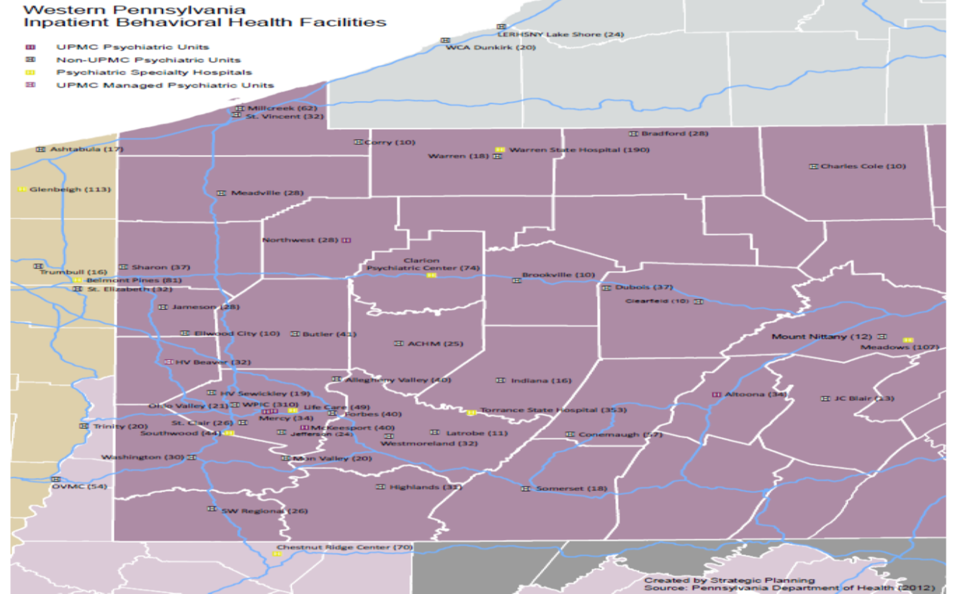
UPMC Behavioral Health Service Line

Slide 4

Northwell Behavioral Health Programs
Northwest Region Inpatient Psychiatry units
508 Inpatient Psychiatry Beds in 10 locations
141 Substance Abuse Beds in 3 locations
12,000+ Inpatient Psychiatry Discharges (annualized 2016)
6,000+ Substance Abuse Discharges (annualized)
Overall Inpatient Occupancy 85%
Outpatient Volume = 335119 visits (annualized)
Outpatient Registrants = 15384 (annualized)
Central Region Inpatient Psychiatry Units
Eastern Region Inpatient Psychiatry Units
Facility with Outpatient Mental Health and Substance Abuse Programs
˜
*
Facility with Outpatient clinics
Facility with Substance Abuse Inpatient Beds
*
NWHC
15 Psych Beds
Phelps Hosp.
22 Psych Beds
42 SU Rehab Beds
Huntington
21 Psych Beds
Syosset
20 Psych Beds
Lenox Hill
28 Psych Beds
ZHH
222 Psych Beds
South Oaks
145 Psych Beds
54 Adult
26 Geriatric
50 Adolescent
15 Pre-Adolescent
52 Sub Abuse Beds
24 Detox Beds
28 SU Rehab Beds
*
SIUH-South
35 Psych Beds
24 SU Rehab Beds
23 Detox Beds (licensed for 56 Detox)
*

Slide 5
Current Focus
Ambulatory Network Development
Value Based Purchasing
Population health
Integrated Care

Slide 6




Integrated Care Locations
5 Reverse Integration Sites
5 Pediatric Sites
15 Adult Sites

Slide 7
Growth of health systems
…and the need for physician leadership

Slide 8
Horizontal Integration
Horizontal integration (hospital-hospital acquisitions)
  better collaboration
  prioritize programs
  increase purchasing power
  consolidate services
  cut costs
Notes:
Economies of Scale
Strategic factors – Market share
Consolidate services and locate them strategically
Increase purchasing and negotiating power

Slide 9
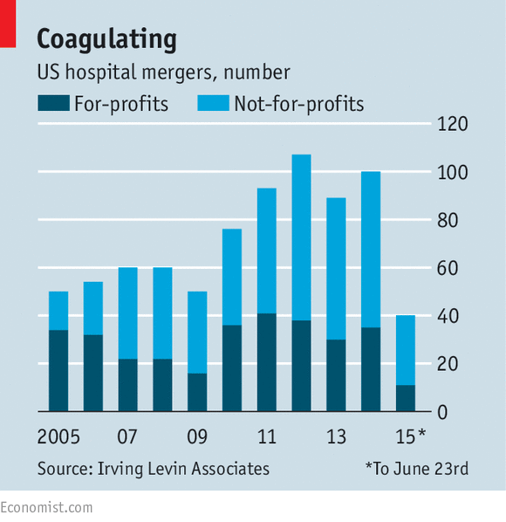

US Hospital Mergers
Notes:
One trend is healthcare consolidations. No one knows how big a health system needs to be to survive the marketplace but the days of stand alone hospitals are numbered. Strategically , we are seeing providers increasing scale by engaging in horizontal integration. This is data on deals done till June 2015 . You can see the sustained trend since mid 2000’s of increasing number of hospital mergers.

Slide 10
Vertical Integration
Physicians’ practices
Ambulatory centers
Diagnostic centers
Home care services
Durable medical equipment
Wellness companies
Notes:
Beyond just growing bigger Hospitals are becoming true health care systems.

Slide 11

Opportunities
Aligning incentives for population health
Value based care
Models of care – integrated care
Data analytics
Use of IT in healthcare
Physician leadership

Slide 12
Changing Roles
Transformation of public and private mental health funding
Increased accountability
Horizontal and vertical integration: evolution of systems and networks
Increased needs for fiscal and technological sophistication
  (From Talbott & Hales’ Textbook of Administrative Psychiatry)

Slide 13
Changing Roles - Physician Workforce
More than 75% of physicians could be employed by hospitals or other health care companies before the end of this decade*
  Lack of trust of unknown hospital-appointed physician leaders
  Imposition of measures and procedures without consensus
  Shifts in staff loyalty
  Loss of relationships with team members in a more matrixed system
  Lack of connections and collegiality with specialists
*American Hospital Association, Environmental Scan 2015
Notes:
What is happening to us the physicians ?
We find ourselves to be corporate employees

Slide 14
Why do we need psychiatric leadership?
Progressive increase in complexity of organized public and private delivery systems
Opportunities to achieve economies of scale in service line strategies
Changing methods for financing care
Defining Value : seeking quality in changing landscape
We need champions for recovery and transformation of mental health care delivery

Slide 15
Types of Medical Staff Structure
CMHC/ CBO - Single medical director for an agency in or a primary medical director and several associate medical directors
Hospitals – Chair / Medical director and associate Medical directors for specific programs
Role of Chair Vs Medical Director
Multi- Hospital Health System – evolving service line strategies- usually highly matrixed organizations

Slide 16
UPMC BH Service Line
Centralized management of inpatient psychiatric units, ED and C&L services
The Team
  Medical Director
  Clinical Program Director (PhD)
  Administrative Director (RN, MBA)
  Quality and Safety Consultant
  Financial Consultant
Use one blueprint to develop services but accommodate local needs and culture
Matrix reporting structure with hospital leadership
Notes:
Okay so now I want to move on to some programs to show how this vertical integration works.
First I want to highlight the group BHS
This group basically is a management group that will provide day to day management of your whole psychiatry department at any community hospital
We use the same group for all UPMC hospitals which have inpatient psychiatry services
And as we also market our services beyond UPMC hospitals and manage other hospitals in the community.

Slide 17


Creating the Blueprint
Clinical policies
Coding and Billing expertise
Standardization of clinical documentation
Staffing ratios
Environmental rounds/physical plant standards
Administrative reporting structures
Quality Metrics
In-House expertise for all disciplines
Notes:
Same BH policies. Standardization of detox protocols, BH precautions, suicide assessments
Central physician billing
Same EMR
Central monitoring of compliance
Mock JC , DOH surveys
Environmental rounds
Same training for staff members
Frankly sometimes only thing I struggle with is local physician practices and physician culture. Not just psych
Most important aspect of my role is to go into a hospital , but that ID badge on , and I have several in my car, but when I put that badge on , walk into that hospital , I take on that culture. Yes there are things we standardize but I have limited control on hospital culture and local community, the psychiatrists who has been well integrated into that system for years. Use McKeesport Hospitalist example, MCK C/L funding. Importance of relationships in my job

Slide 18
Career Pathway
Tips for growth and success

Slide 19
Critical Administrative Competencies
Understanding the nature of the formal organizational structure
Developing and using protocols, policies, and procedures to standardize administrative and clinical functioning
Developing and using job descriptions, productivity standards, and employee evaluation instruments
Developing basic competency in fiscal, regulatory, and reimbursement issues
  (From Talbott & Hales’ Textbook of Administrative Psychiatry)

Slide 20
Maintaining a Collaborative Presence in the Management Team
Key Relationships
  Chief Executive Officer
  Management and Supervisory Staff
  Clinical Staff
  Consumers and Patients
  Board of Directors
  Consumer and Family Advocacy Organizations
  Outside Clinical Liaisons
  Third Party Payers
  Policymaking and Regulating Entities
  Organizations Involved in Training, Research, and Program Evaluation
  (From Talbott & Hales’ Textbook of Administrative Psychiatry)

Slide 21
Challenges
ROADBLOCKS TO CLINICAL LEADERSHIP
  Getting a Seat at the Table
  Establishing Protected Time
  Navigating Old-School Attitudes
  Keeping Work – Life Balance
  Maintaining Collegiality with Colleagues
  Developing Key Management Skills (formal education)

Slide 22
How to Get Physician Executive Jobs
Become a Board-Certified Clinician who has practiced for 3-5 years
  Physicians respect other physicians most for their clinical work
  Only gradually do they come to respect physician executives for their management skills.
  (From ACPE’s Essentials of Medical Management)

Slide 23
How to Get Physician Executive Jobs
Get management experience
  Volunteer to serve on and lead committees
    Utilization review
    Quality assurance
    Privileging
    Credentialing
  Take a job as an elected officer
  Work quality assurance part time
  (From ACPE’s Essentials of Medical Management)

Slide 24
Key Skills
Fine tune your Interpersonal Communication Skills
Run short, effective meetings

Slide 25
How to Get Physician Executive Jobs
Network - American Association of Psychiatric Administrators
Get Education
  ACPE/AAPL trainings
  Master’s degree (MBA vs MMM)
  Evaluate benefits Vs investment
Q : “What formal education do I need?”
A : “ Everyone has a unique situation so evaluate your professional goals, current skills and create your own roadmap”

